Slide 1
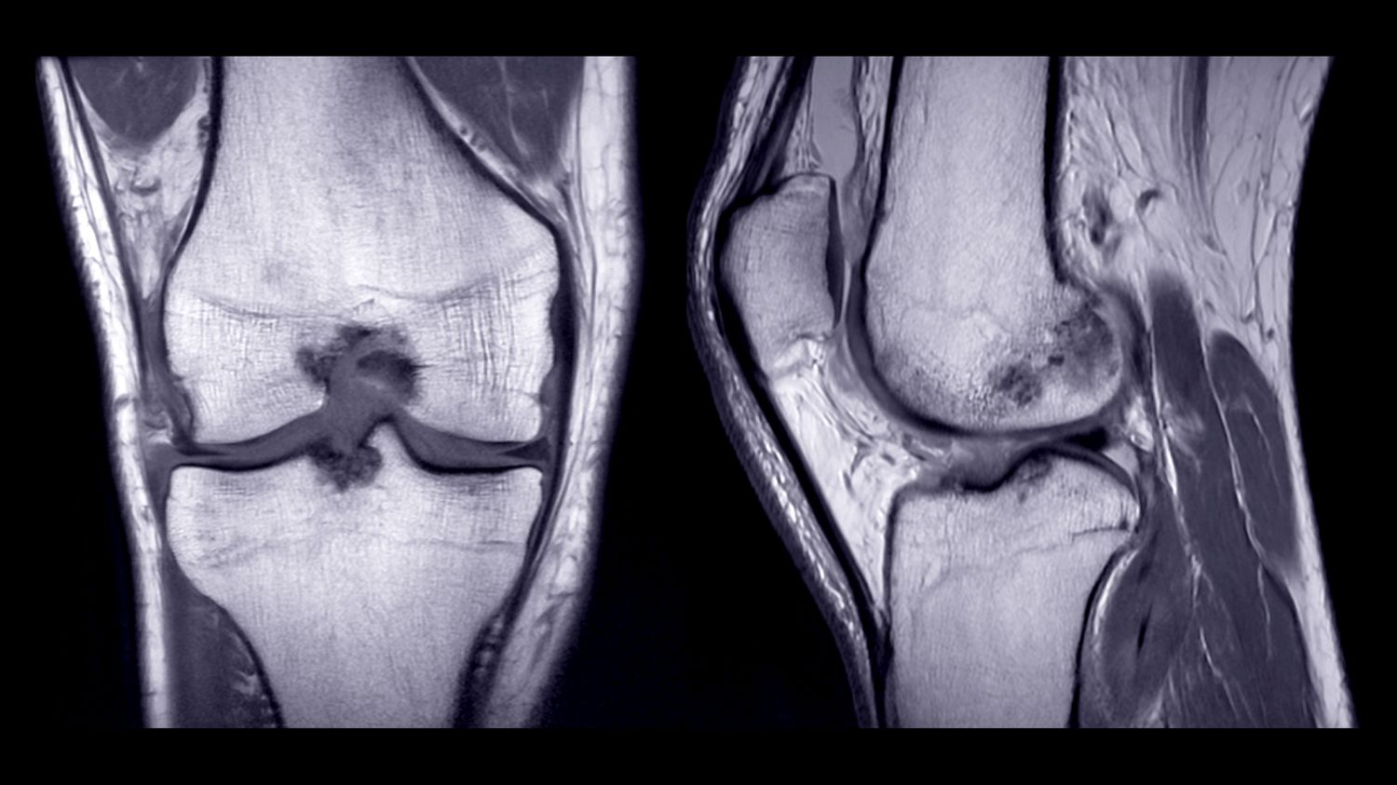
Chapter 9: Articulations
image: MRI of the tibiofemoral (knee) joint
Dr. Paige Morgan Laramie County Community College

Slide 2
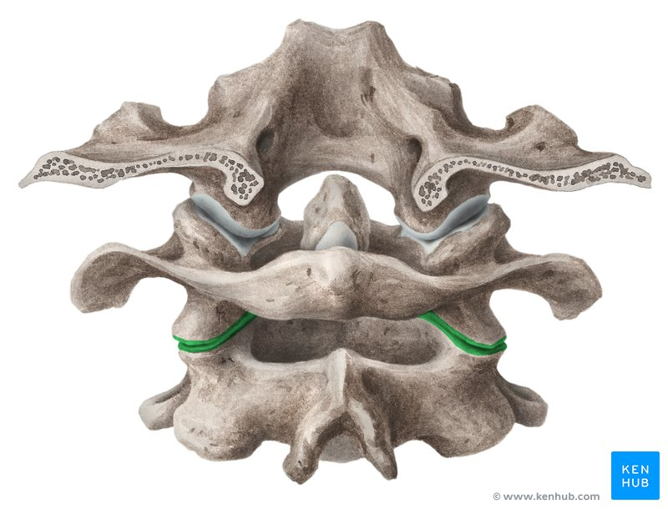
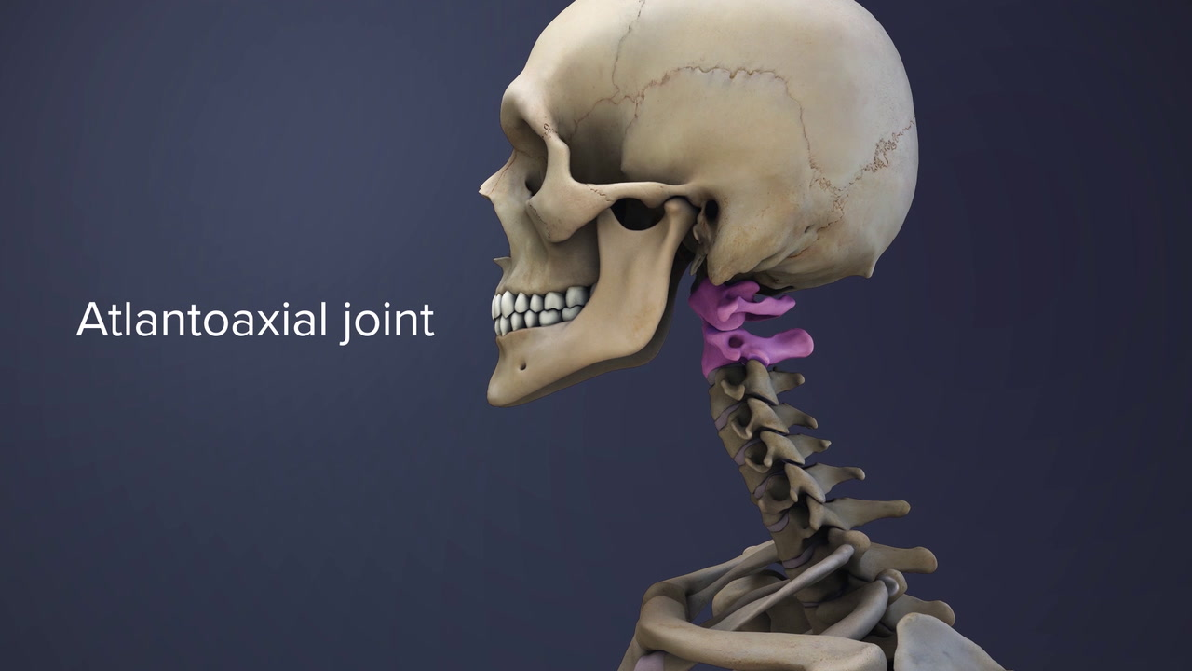
Joint Nomenclature
joints are often named for the 2 bones that they articulate:
ex. glenohumeral (aka “shoulder”) = glenoid cavity (of scapula) + humerus
ex. tibiofemoral (aka “knee”) = femur + tibia
ex. temporomandibular (aka “TMJ” or “jaw”): temporal bone + mandible
ex. sternoclavicular: sternum + clavicle
ex. atlantoaxial: atlas (C1) and axis (C2)
2

Slide 3
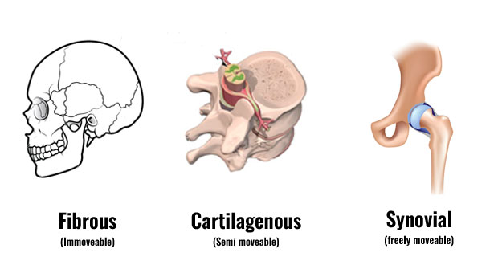
Joint Classifications
[1] fibrous joints: → held together by dense irregular connective tissue → also rich in collagen fibers → no synovial cavity
[2] cartilaginous joints: → held together by cartilage → no synovial cavity
[3] synovial joints: → bones are united by the dense irregular connective tissue of an articular capsule → bones forming the joint have a synovial cavity
joints can also be classified based on the degree of movement they permit:
synarthrosis: an immovable joint (ex. cranial sutures)
amphiarthrosis: a slightly moveable joint (ex. cartilaginous joints between the vertebrae)
diarthrosis: freely moveable joint (ex. glenohumeral/shoulder joint) (all diarthroses are synovial joints)
3

Slide 4
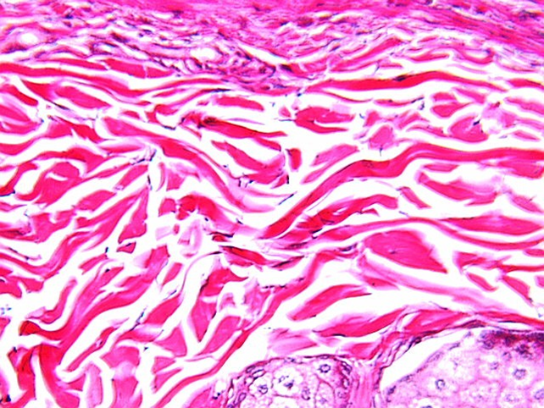
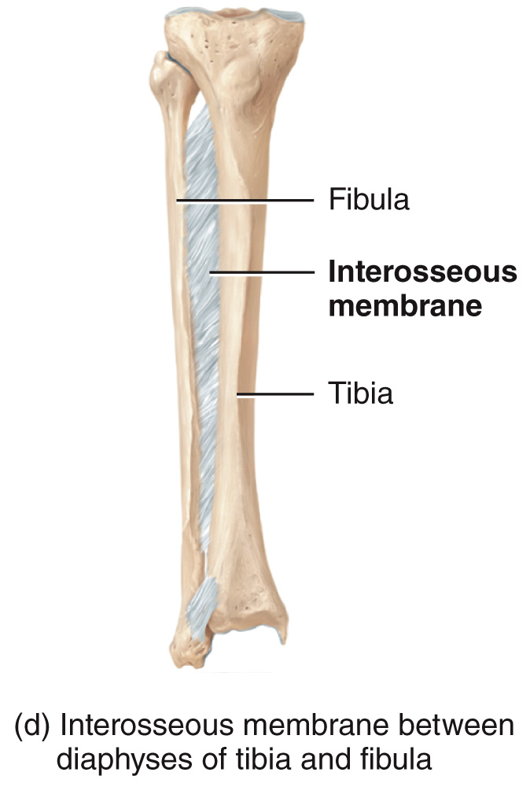
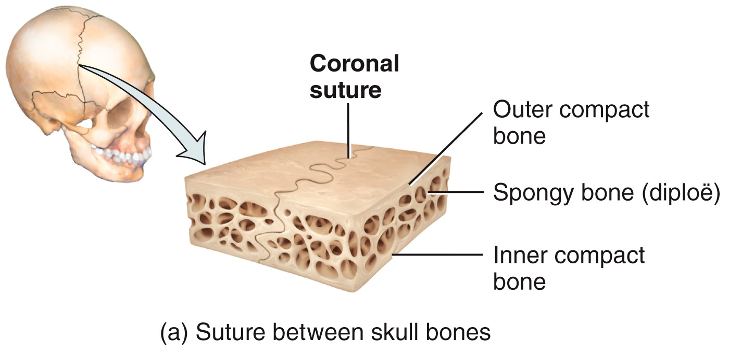
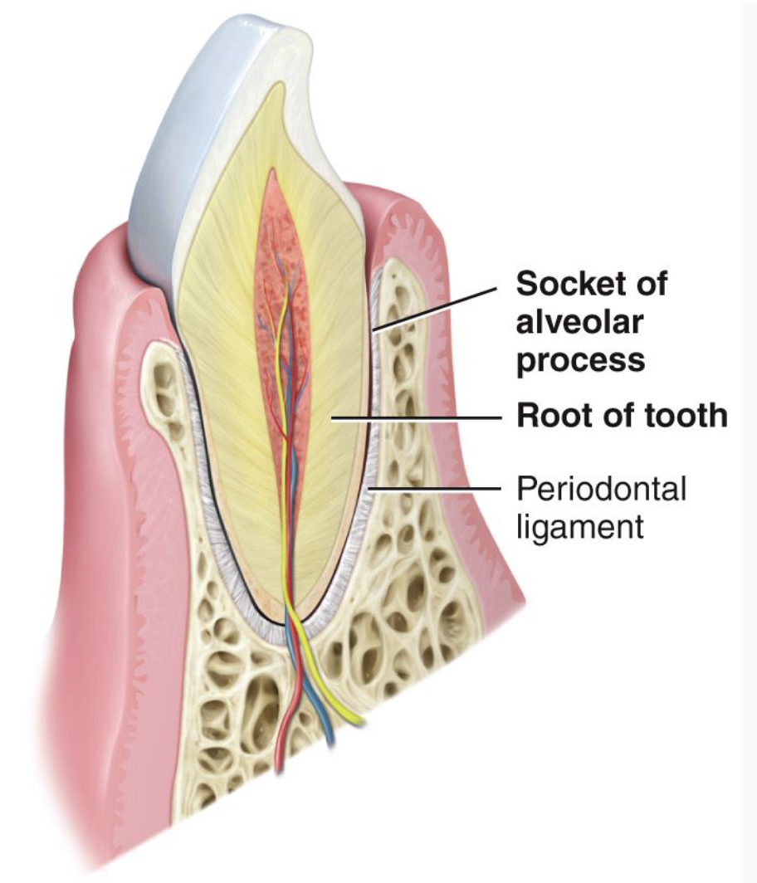
Joint Classifications – Fibrous
[1] fibrous joints: → held together by dense irregular connective tissue → also rich in collagen fibers → permit little to no movement → no synovial cavity there are 3 types:
dense irregular connective tissue
suture: a fibrous joint composed of a thin layer of dense irregular connective tissue
2
syndesmoses: a fibrous joint in which there is a greater distance between the articulating surfaces and more dense irregular connective tissue than in a suture
3
interosseous membrane: a substantial sheet of dense irregular connective tissues
1
4

Slide 5
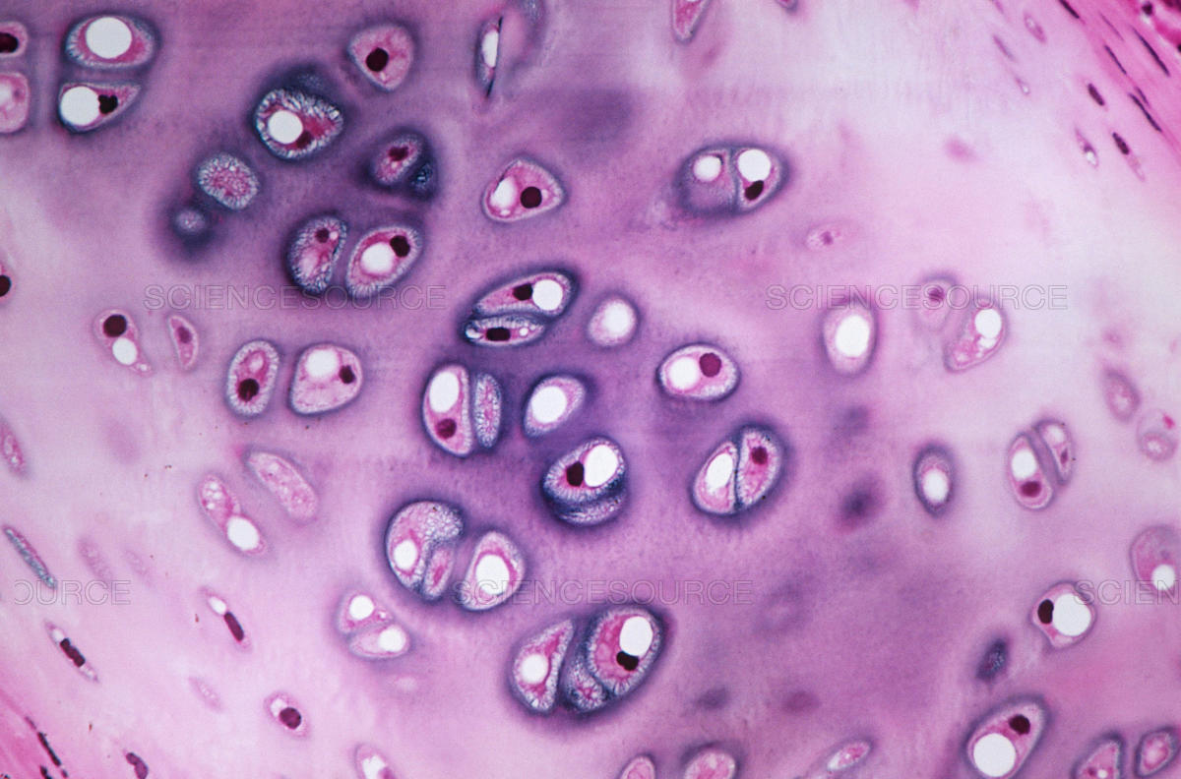
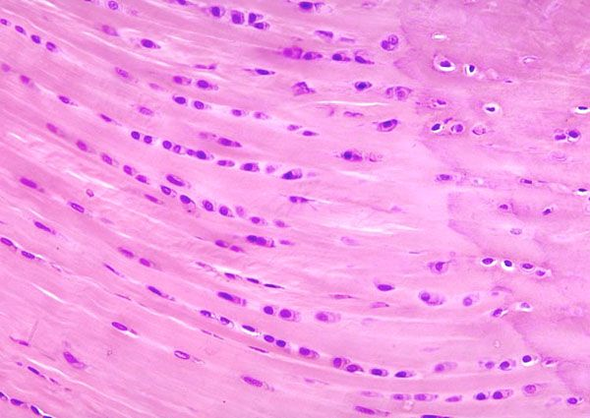
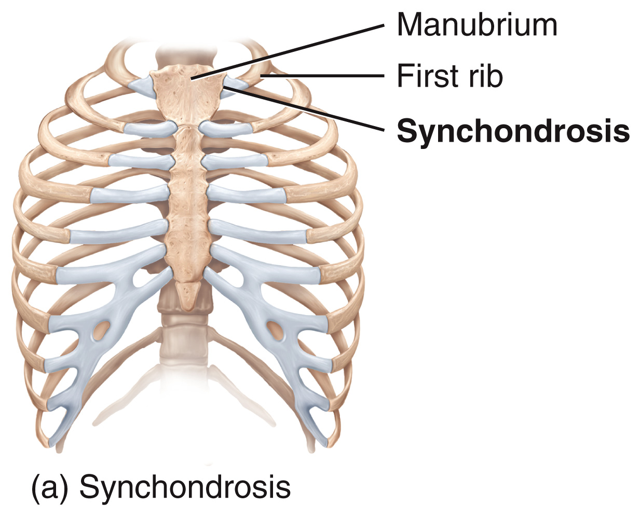
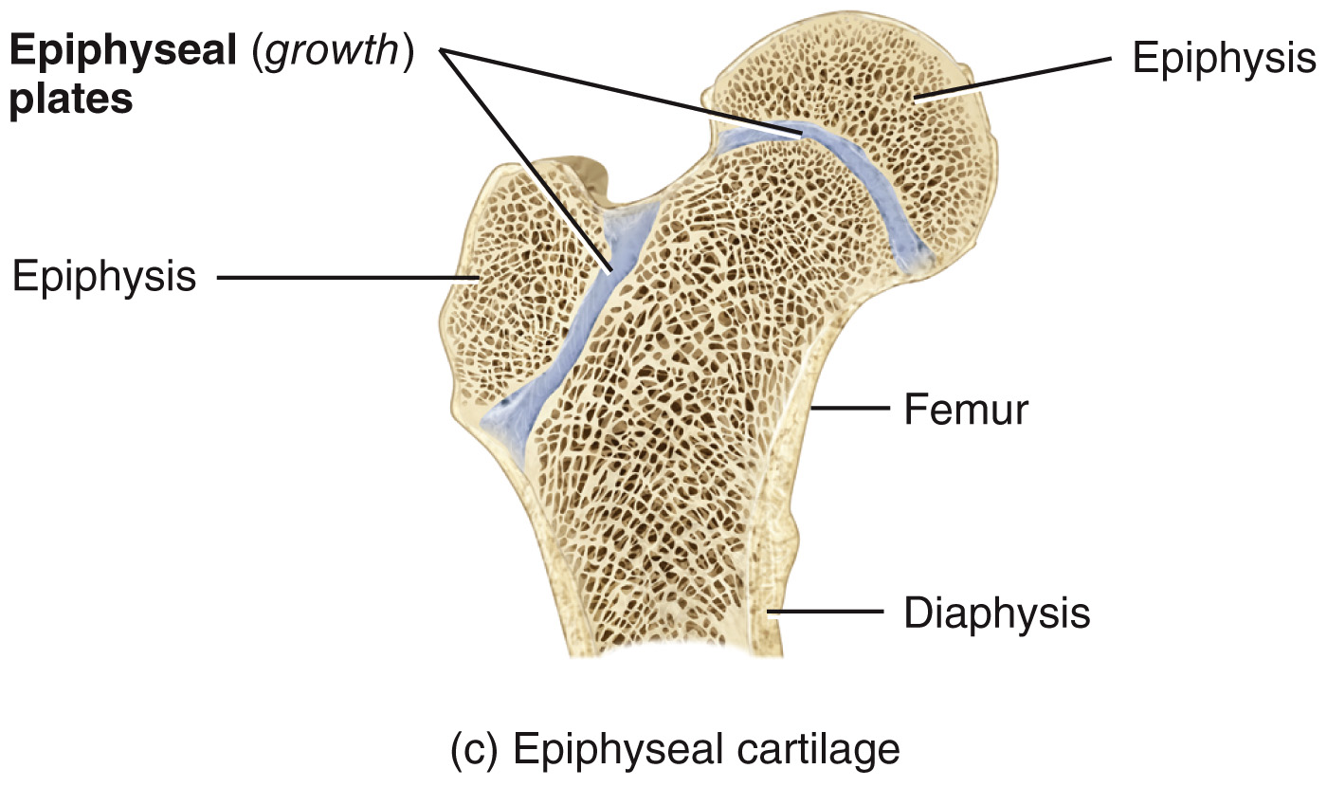
Joint Classifications – Cartilaginous
[2] cartilaginous joints: → held together by cartilage *which can be hyaline or fibrocartilage* → permit little to no movement → no synovial cavity there are 2 types:
hyaline
fibrocartilage
1
synchondroses: cartilaginous joint in which the connecting material is hyaline cartilage → a synchondroses is an immovable joint (synarthrosis) ex. epiphyseal growth plate that connects the epiphysis and diaphysis of growing bone during development, bone replaces cartilage and the synchondrosis becomes a synostosis (aka bony joint) ex. joints between the ribs and the sternum
5

Slide 6
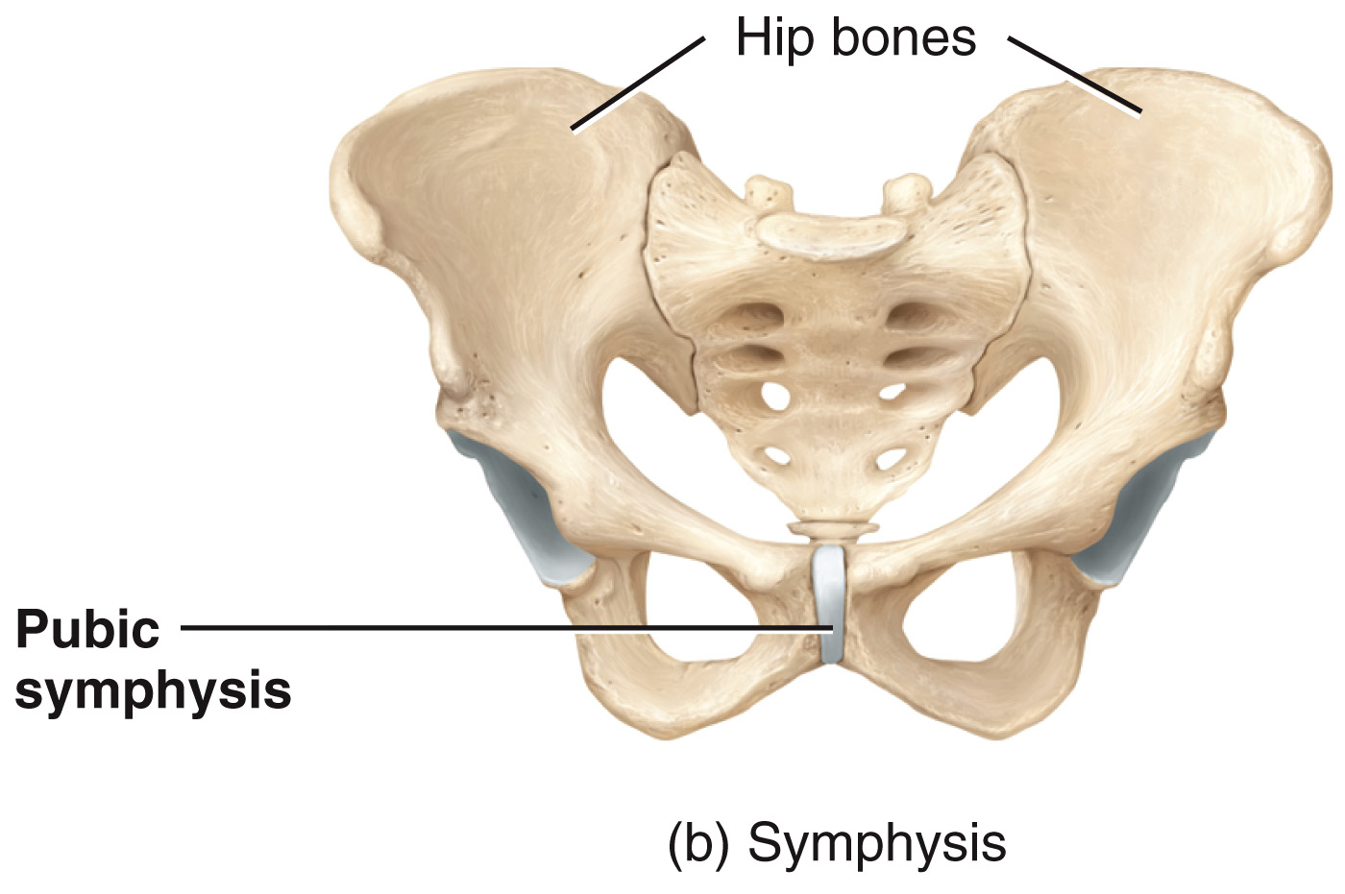
Joint Classifications – Cartilaginous
[2] cartilaginous joints: → held together by cartilage *which can be hyaline or fibrocartilage* → permit little to no movement → no synovial cavity there are 2 types:
hyaline
fibrocartilage
2
symphyses: cartilaginous joint in which the ends of the articulating bones are covered with hyaline cartilage but a broad, flat disc of fibrocartilage connects the bones ex. pubic symphysis ex. junction of the manubrium and body of the sternum ex. joints between the vertebrae
6

Slide 7
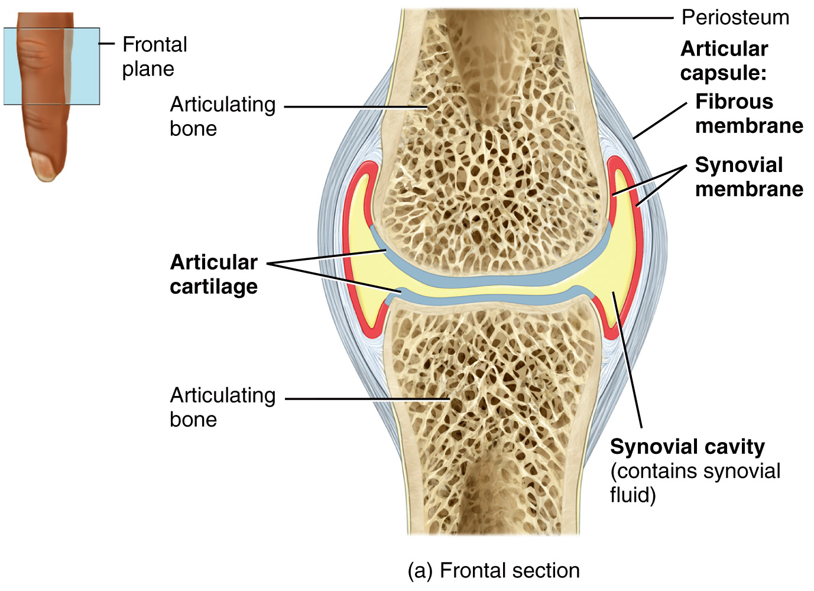
Joint Classifications – Synovial
[3] synovial joints: → bones are united by the dense irregular connective tissue of an articular capsule → bones forming the joint have a synovial cavity = allows for considerable movement → all synovial joints are diarthroses (freely moveable)
fibrous membrane: dense irregular connective tissue that attaches the periosteum of articulating bones
synovial membrane: areolar connective tissue w/elastic fibers that houses synoviocytes = cells that secrete synovial fluid
synovial fluid: viscous liquid, containing hyaluronic acid, that cushions the joints and reduces friction between articulating bones
articular cartilage: layer of hyaline cartilage (2-4mm thick) that covers the surface of articulating bones at synovial joints
7

Slide 8
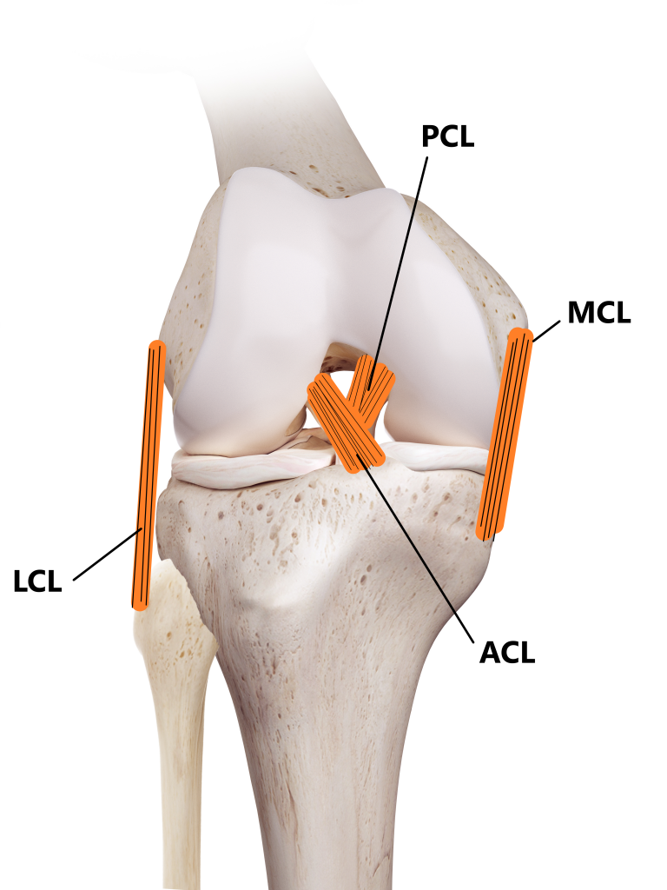
Synovial Joints – Accessory Structures
[1] accessory ligaments: (aka extra and intra capsular ligaments) highly adapted for resisting strain; prevent extreme movements that may damage the articulation
extracapsular ligaments: lie outside of the articular capsule ex. fibular (LCL) and tibial (MCL) collateral ligaments of the knee joint
intracapsular ligaments: occur within the articular capsule but are excluded from the synovial cavity by folds of the synovial membrane ex. anterior (ACL) and posterior (PCL) cruciate ligaments of the knee joint
anterior view (patella removed)
8

Slide 9
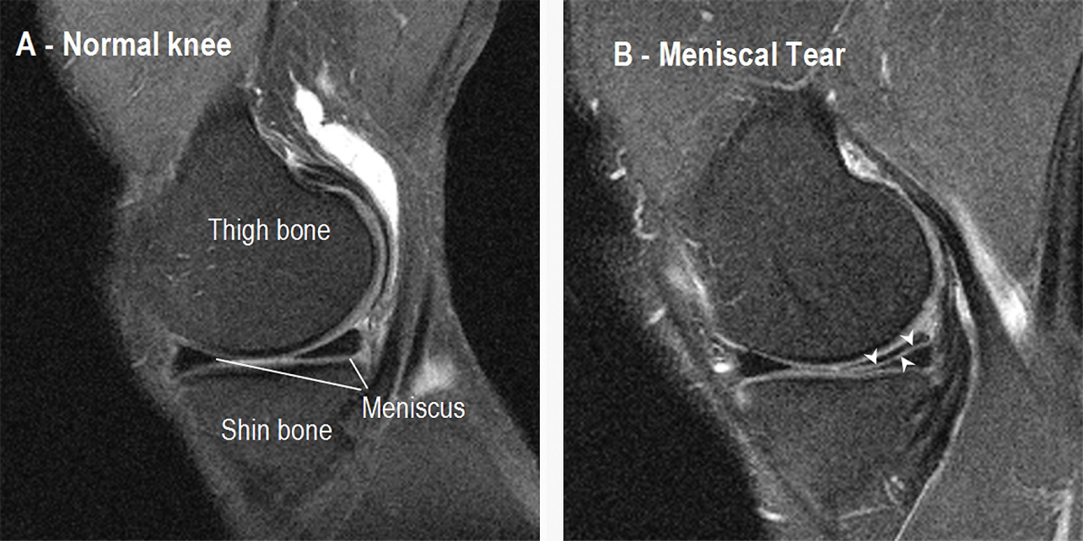
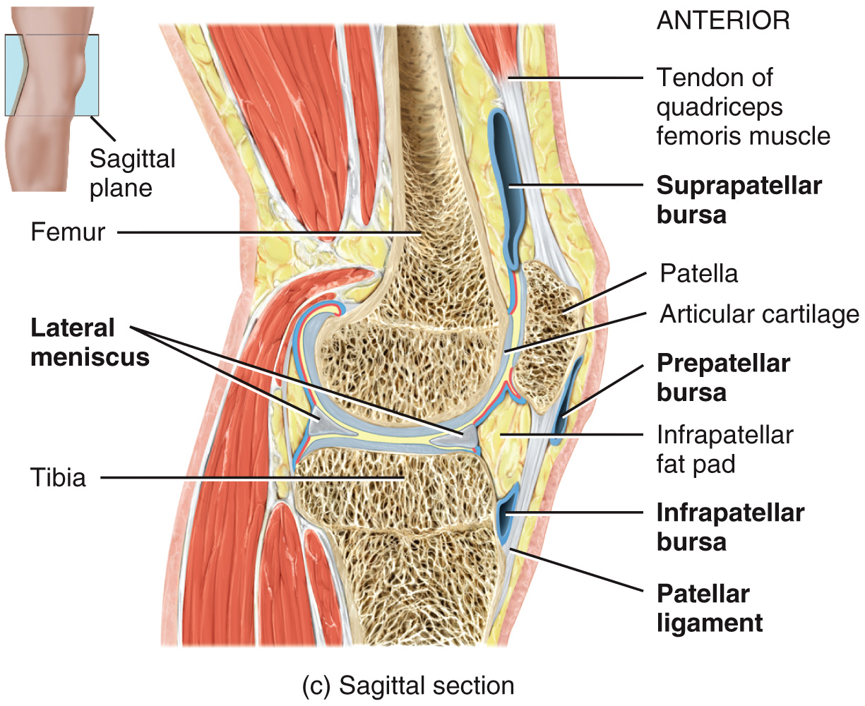
Synovial Joints – Accessory Structures
[2] articular discs: (aka menisci) crescent-shaped pads of fibrocartilage between articular surfaces of the bones that attach to the fibrous capsule → ex. in each knee, there is both a lateral and medial meniscus
tear
MRI, knee, sagittal view right: meniscus tear
9

Slide 10
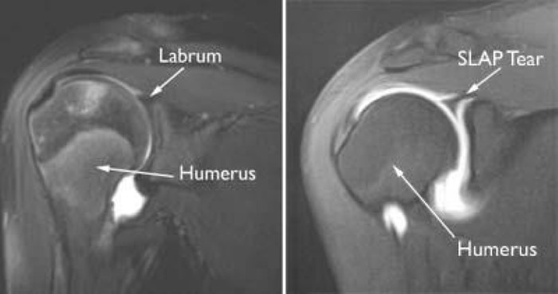
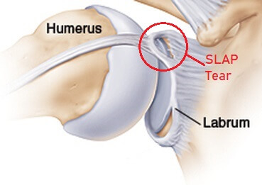
Synovial Joints – Accessory Structures
[3] labrum: fibrocartilaginous lip that extends from the edge of the joint socket
→ helps deepen the joint socket and increase the area of contact between articulating surfaces → ex. prominent in the ball-and-socket joints of the shoulder and hip
MRI w/ contrast, shoulder, coronal/frontal view SLAP = superior labrum, anterior and posterior right: SLAP tear
10

Slide 11
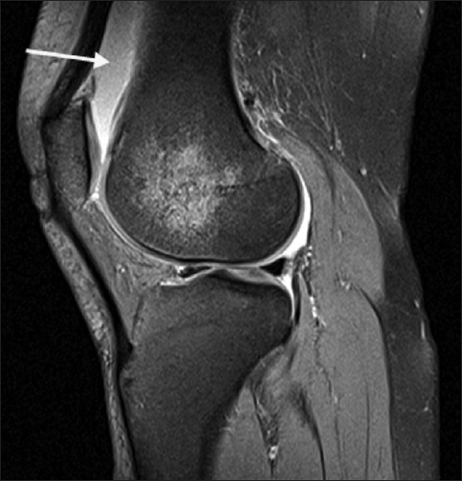
Synovial Joints – Accessory Structures
[4] bursae: fluid filled sacs (similar but different from synovial fluid) that cushion movement at the joint, reducing friction
MRI, knee, sagittal view arrow: suprapatellar bursa
11

Slide 12
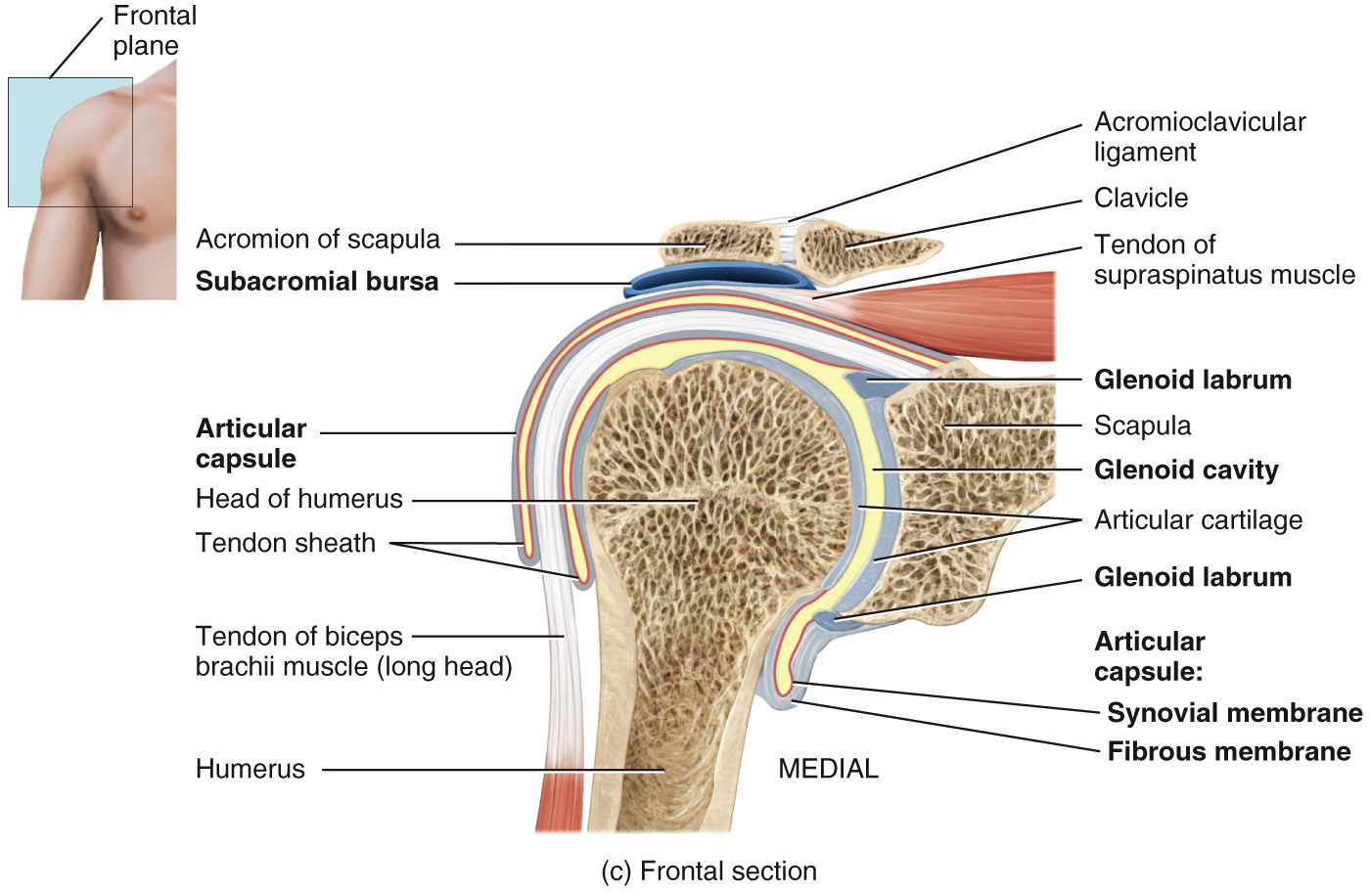
Synovial Joints – Accessory Structures
[5] tendon sheath: tube-like bursae (another way to reduce friction at the joint) → wrap around certain tendons that experience considerable friction → protects all sides of a tendon from friction where tendons pass through synovial cavities ex. tendon of the biceps brachii muscle at the shoulder joint
12

Slide 13
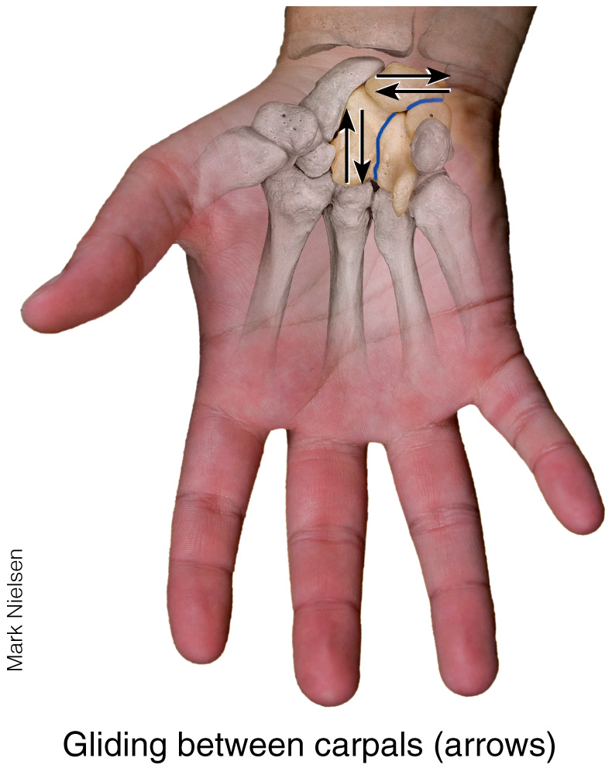
Types of Movement @ Articulations – [1] Gliding
gliding: simple movement in which nearly flat bone surfaces move back-and-forth and from side-to-side with respect to one another ex. intercarpal and intertarsal joints
13

Slide 14
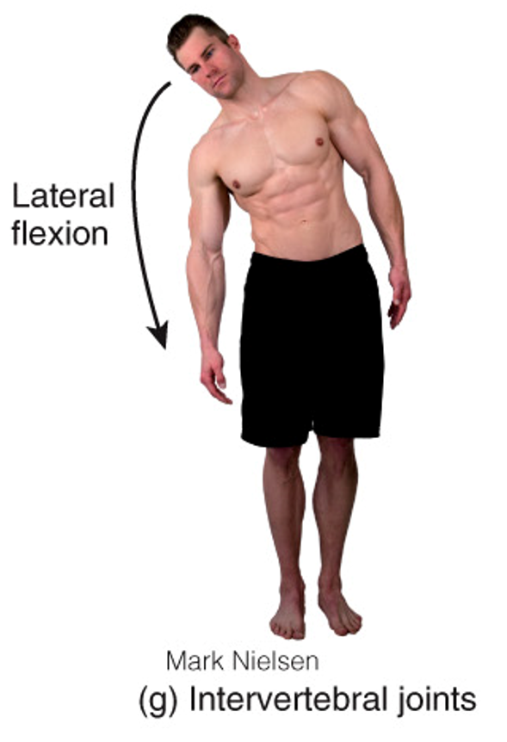
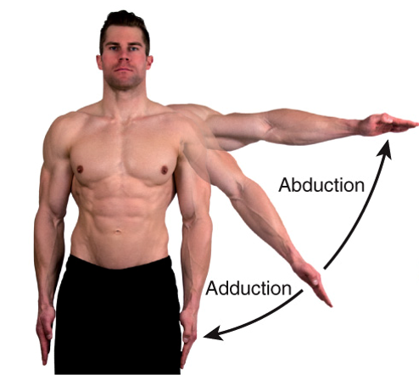
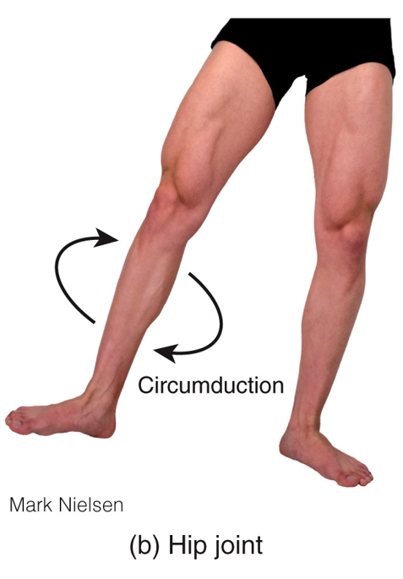
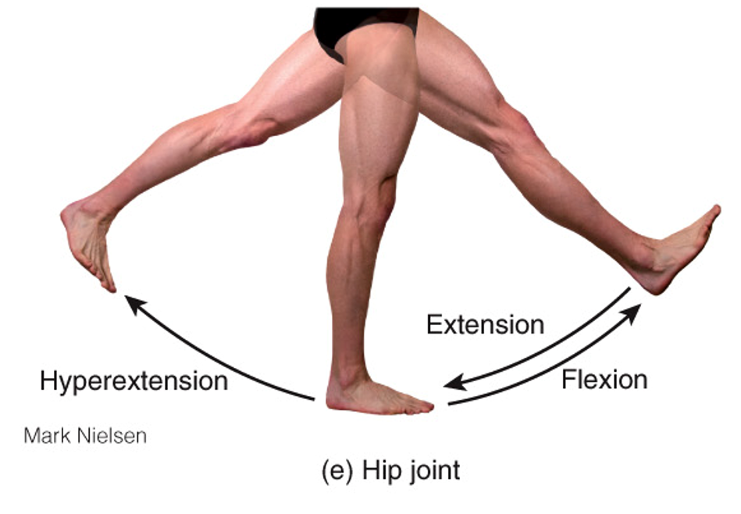
Types of Movement @ Articulations – [2] Angular Movement
angular movement: there is an increase or decrease in the angle between articulating bones [1] flexion = decrease in the angle between articulating bones [2] extension = increase in the angle between articulating bones [3] lateral flexion = occurs along the frontal plane and involves the intervertebral joints [4] hyperextension = continuation of extension beyond the anatomical position [5] abduction = movement of a bone away from the midline [6] adduction = movement of a bone toward the midline [7] circumduction = movement of the distal end of a body part in a circle
14

Slide 15
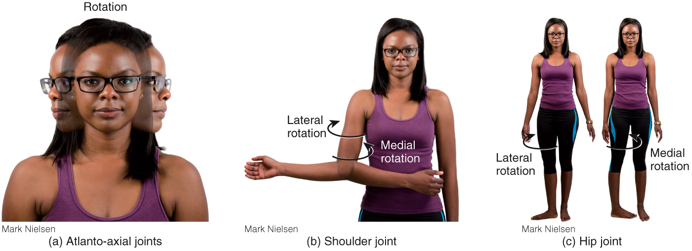
Types of Movement @ Articulations – [3] Rotation
rotation: when a bone revolves around its own longitudinal axis ex. turning the head from side to side at the atlanto-axial joint (between axis and atlas, C1/C2) ex. turning the trunk from side-to-side at the intervertebral joints while keep the hips and lower limbs in anatomical position
15

Slide 16
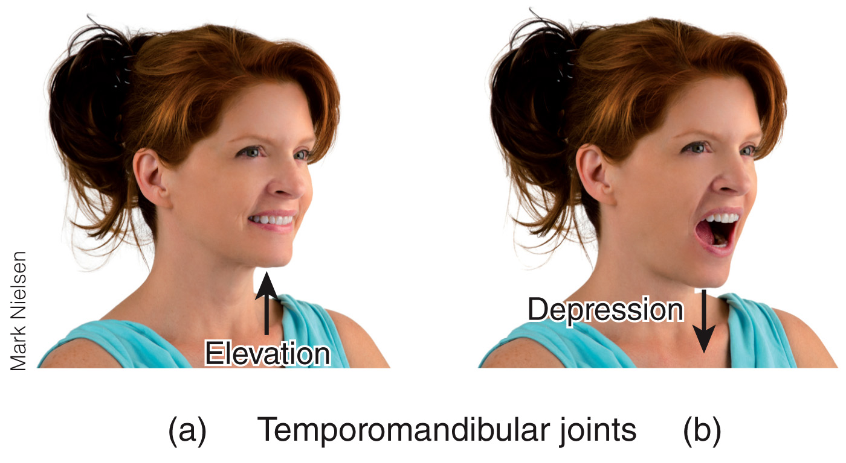
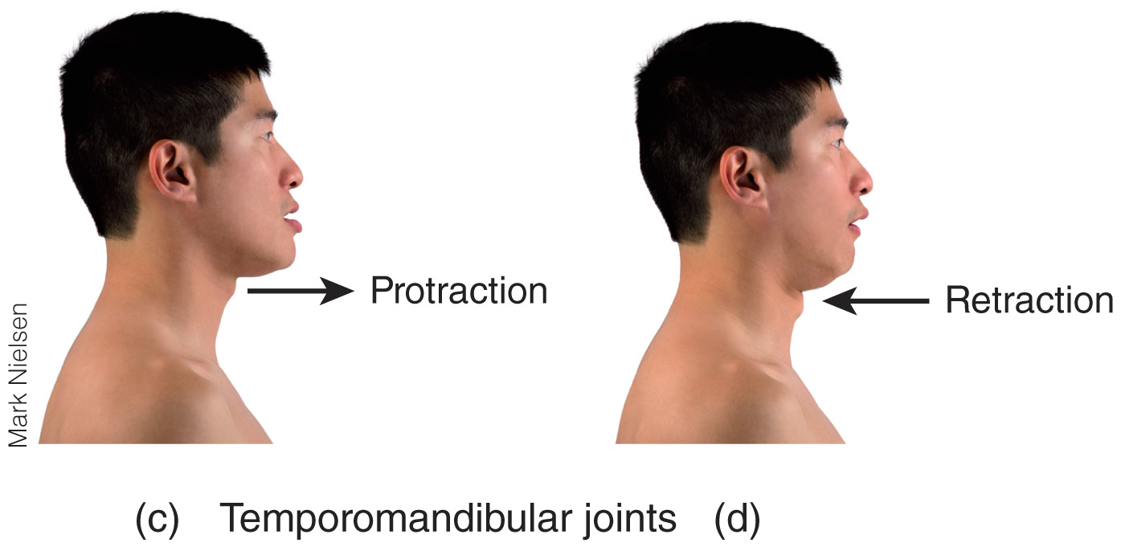
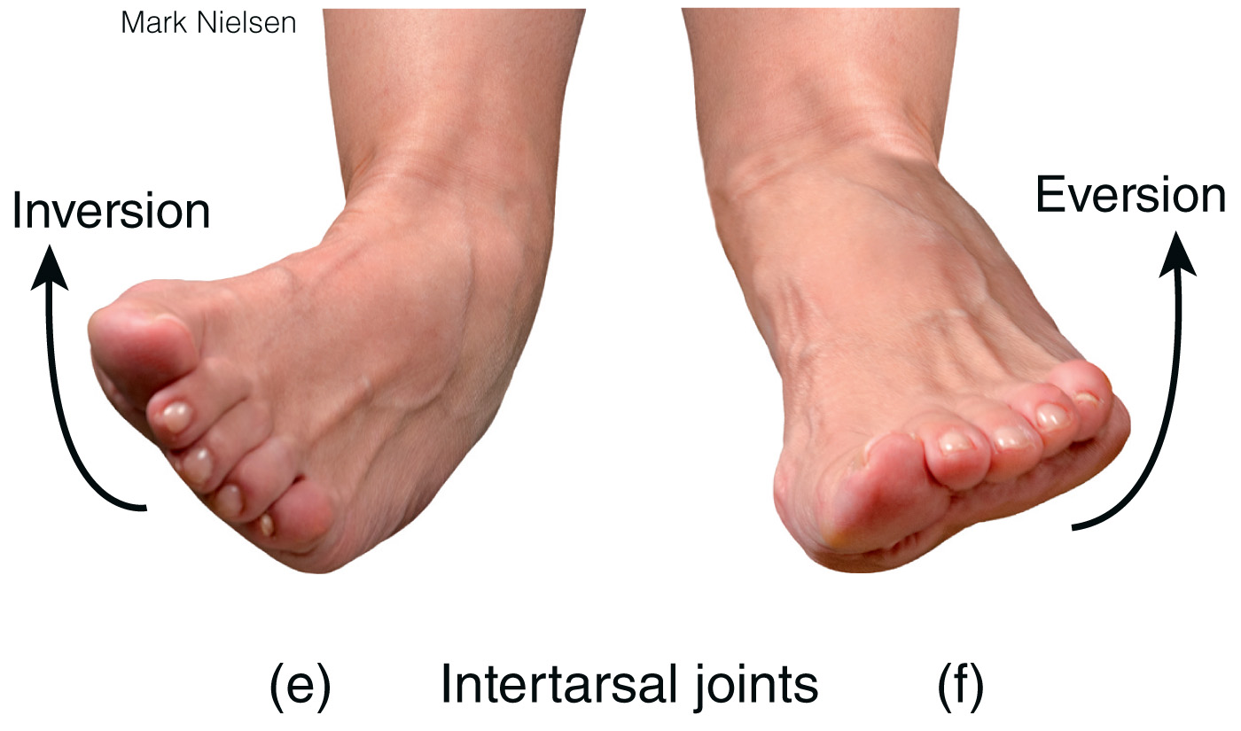
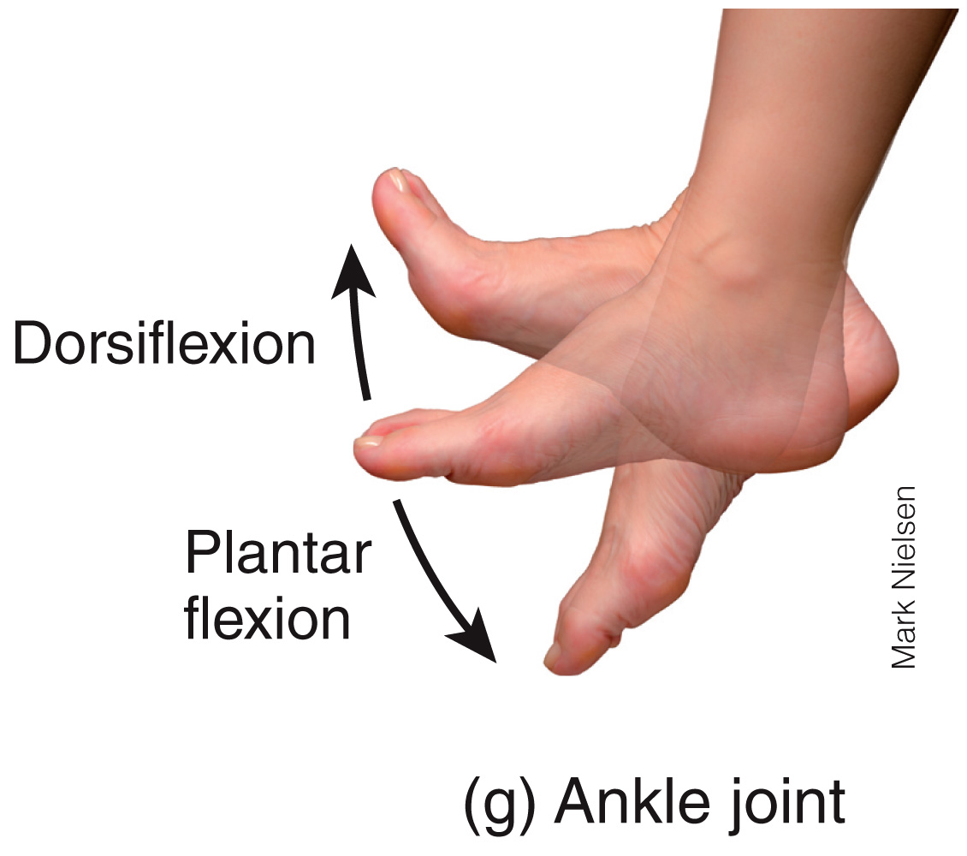
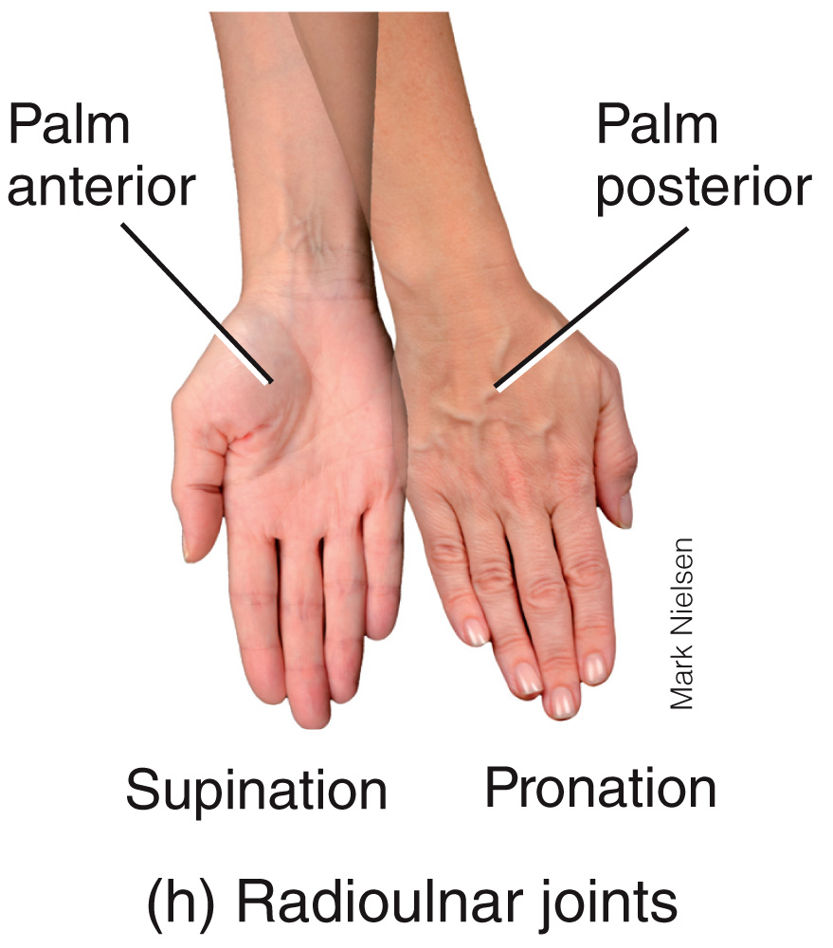
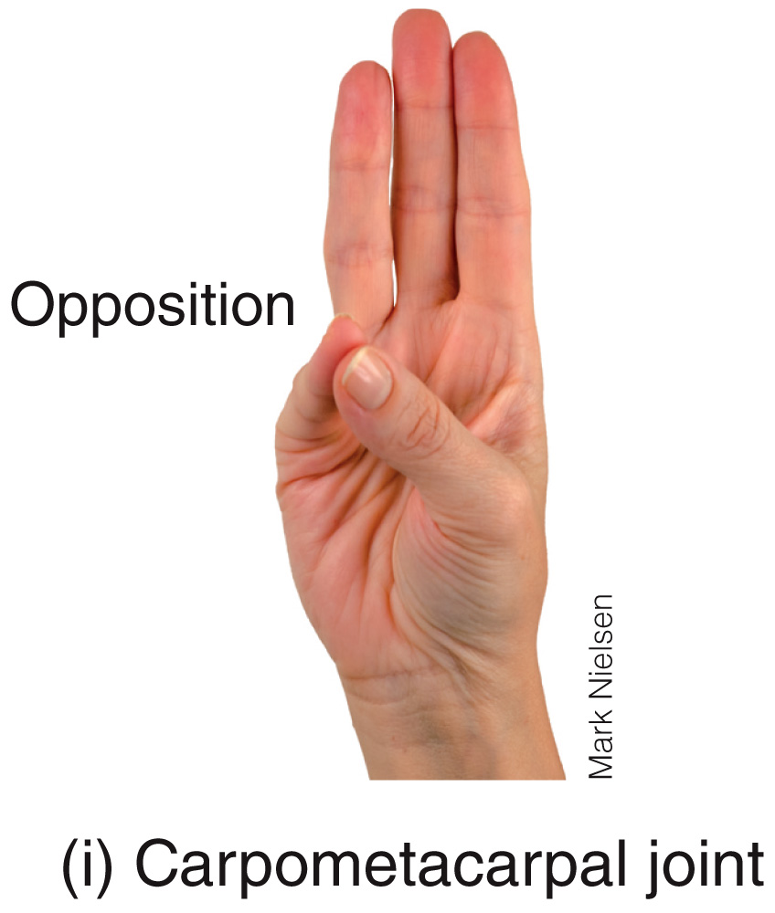
Types of Movement @ Articulations – [4] Special Movements
special movements: occur only at certain joints
elevation
depression
protraction
retraction
inversion
eversion
dorsiflexion
plantar flexion
supination
pronation
opposition

Slide 17
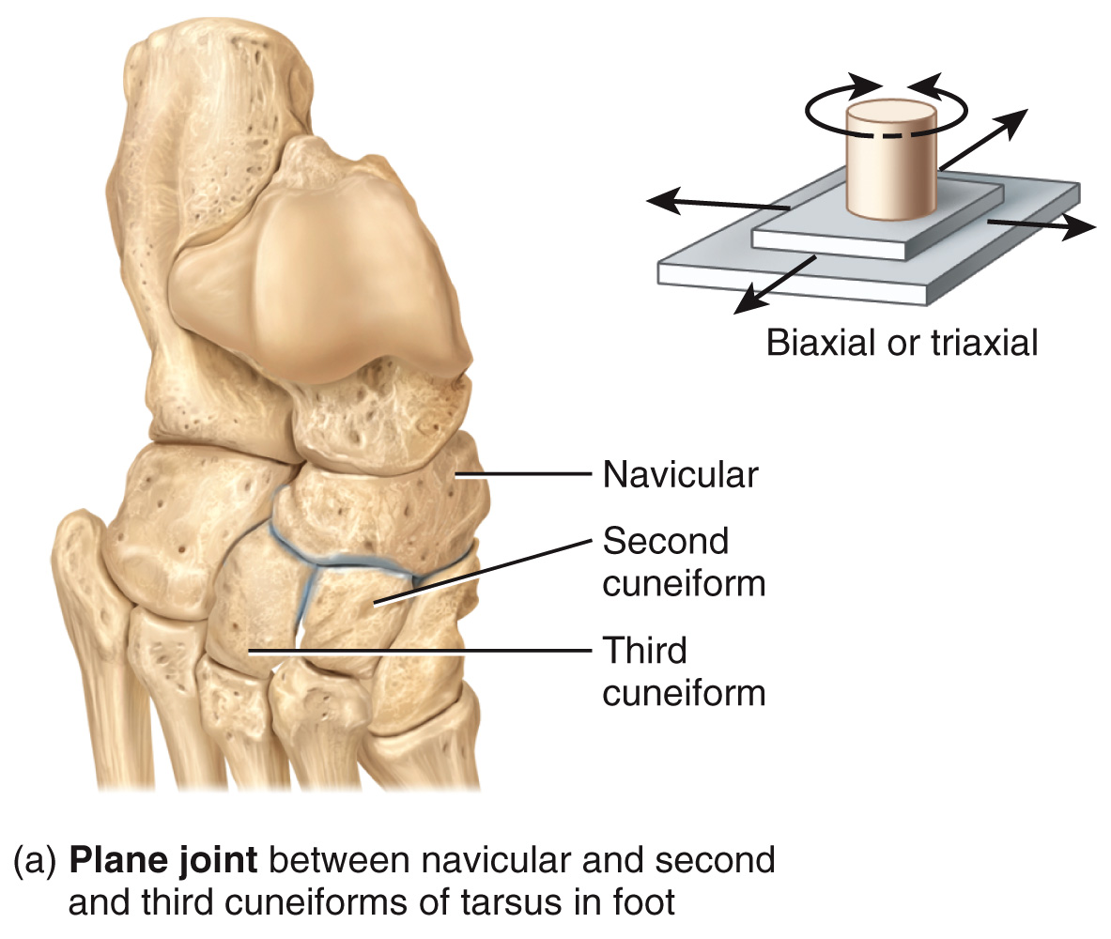
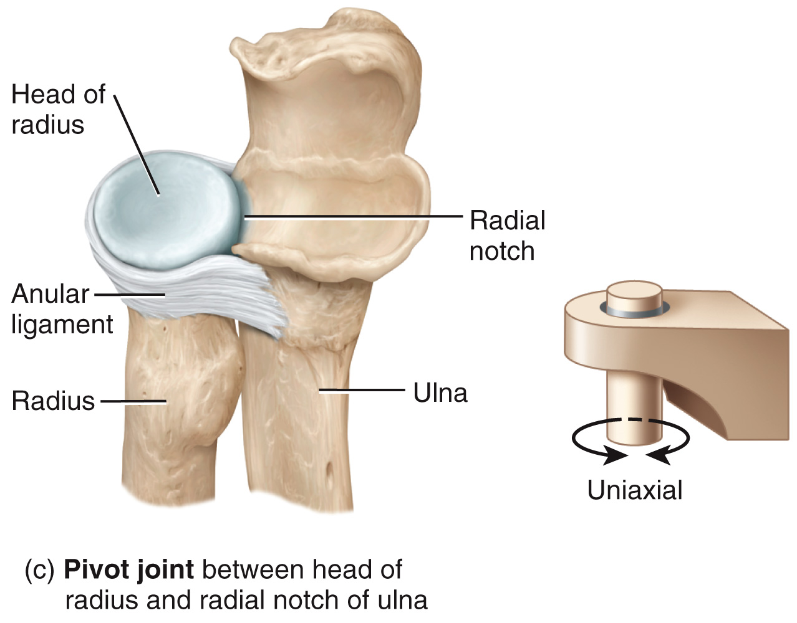
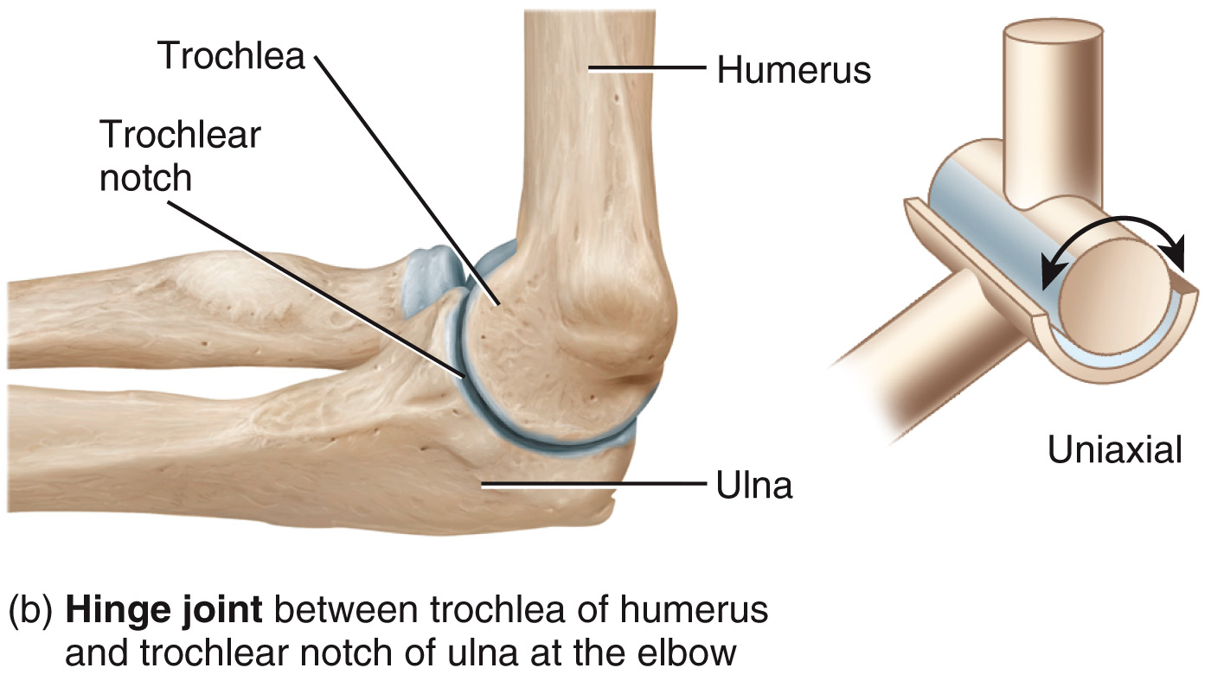
Types of Articulations
plane joint: the articulating surfaces of bones are flat or slightly curved → primarily permit back-and-forth and side-to-side motion ex. navicular and 1st cuneiform
hinge joint: the convex surface of one bone fits into the concave surface of another → produce an angular, opening-and-closing motion like that of a hinged door ex. elbow
pivot joint: the rounded or pointed surface of one bone articulates with a ring formed partly by another bone and partly by a ligament ex. ulna and radius
17

Slide 18
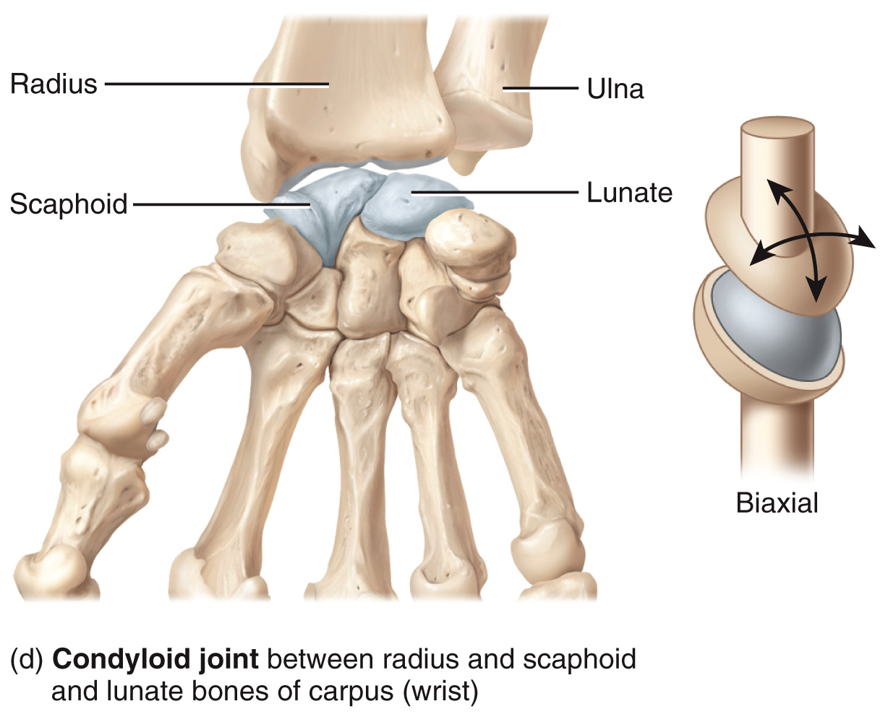
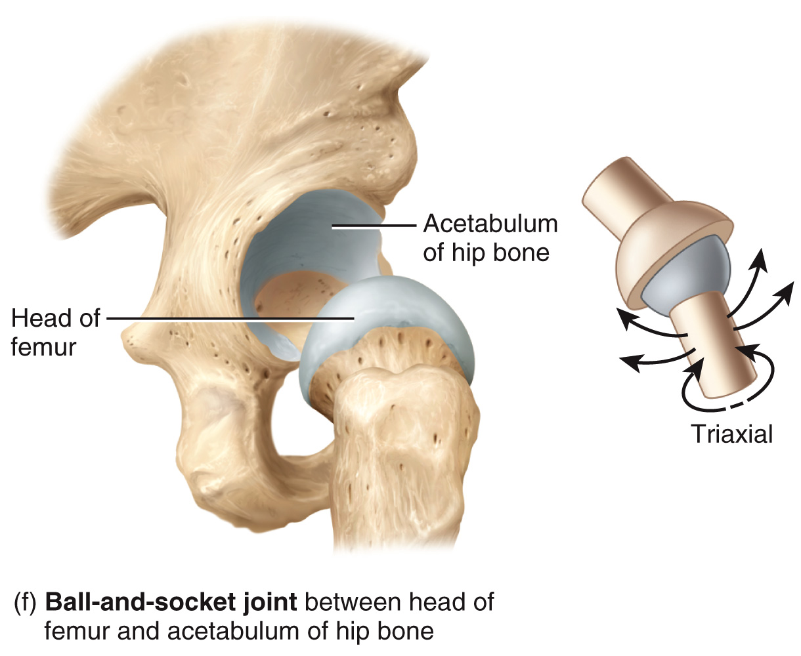
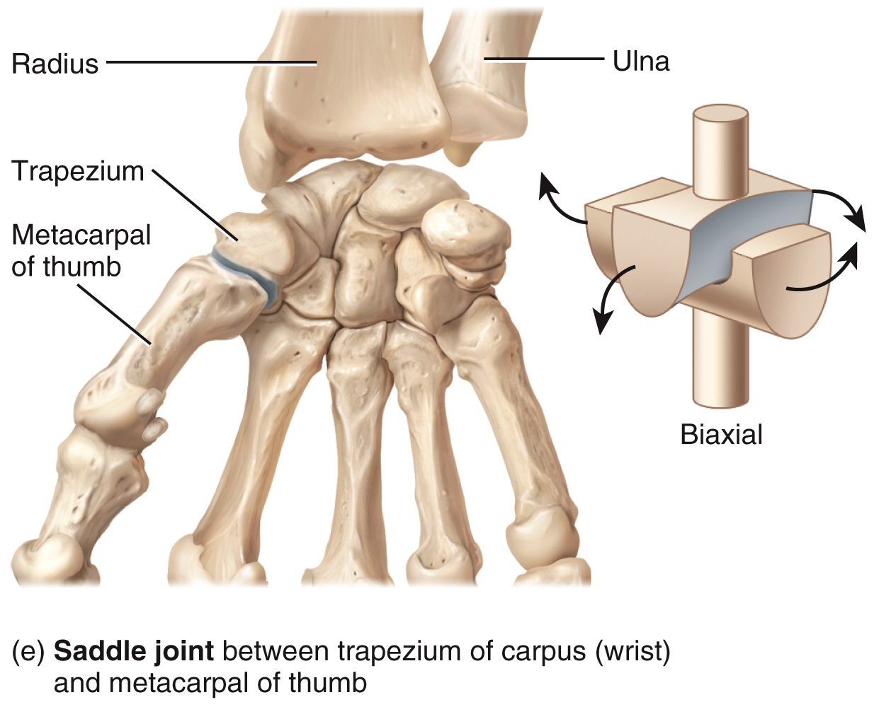
Types of Articulations
condyloid joints: the convex oval-shaped projection of one bone fits into the oval-shaped depression of another bone ex. radius and scaphoid/lunate
saddle joint: the articular surface of one bone is saddle-shaped and the articular surface of the other bone fits into the saddle as a sitting rider would sit ex. trapezium and metacarpal 1
ball-and-socket joints: consists of the ball-like surface of one bone fitting into a cup-like depression of another bone ex. hip and femur
18

Slide 19
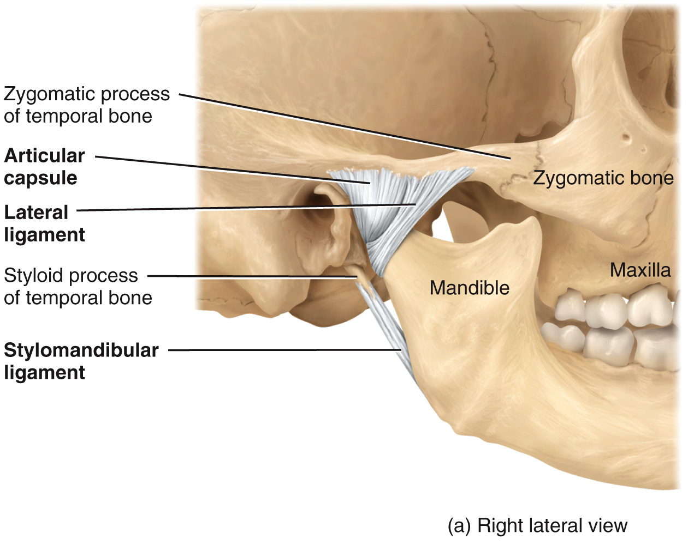
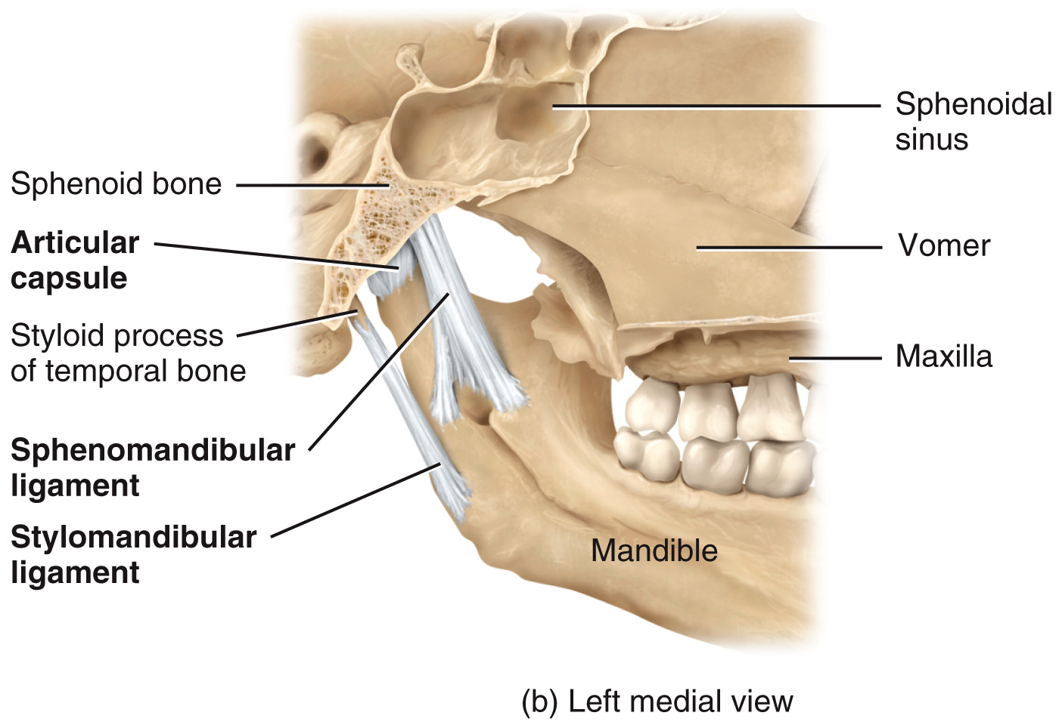
Selected Joints – TMJ
TMJ: a combined hinge and plane joint formed by mandible and temporal bones → it is the only freely movable joint between skull bones (with the exception of ossicles of the inner ear) → allows for depression and elevation of the jaw → allows for protraction and retraction of the jaw
19

Slide 20
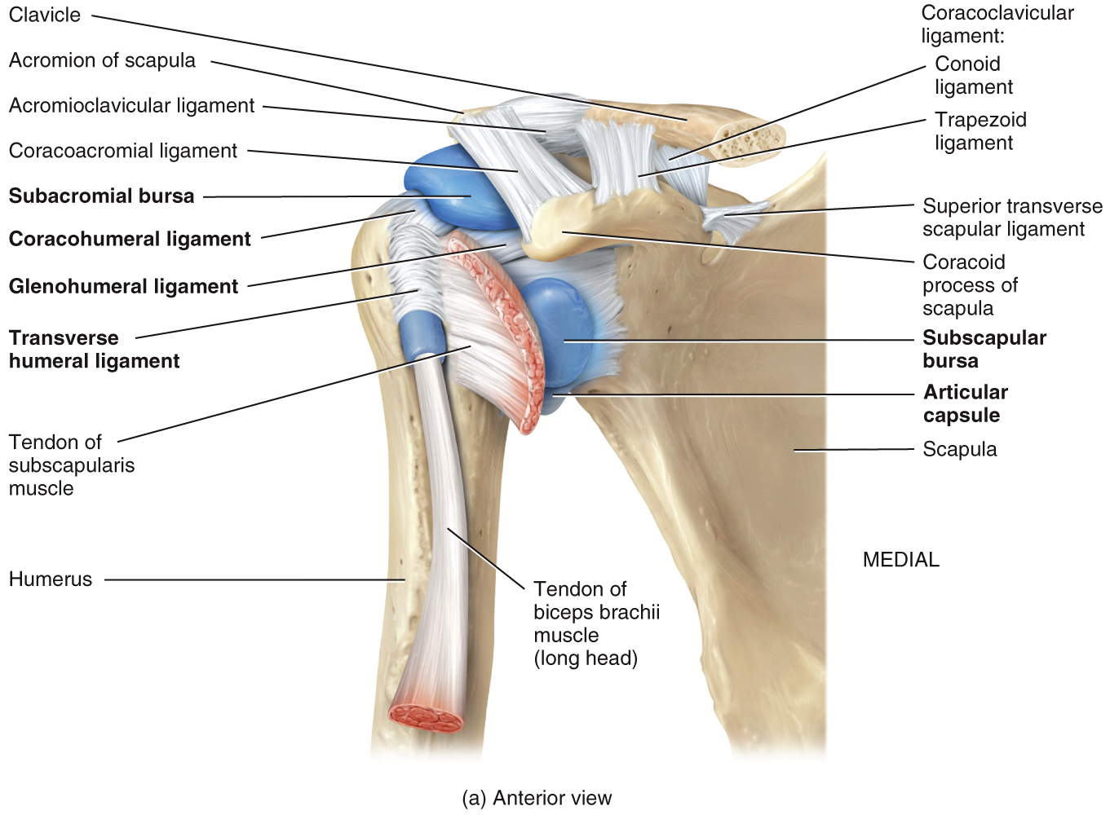
Selected Joints – Glenohumeral (Shoulder) Joint
glenohumeral: a ball-and-socket joint formed by the head of humerus and glenoid cavity of scapula → allows for flexion, extension, hyperextension, abduction, adduction, medial/lateral rotation and circumduction of the arm → has more freedom of movement than any other joint in the body
20

Slide 21
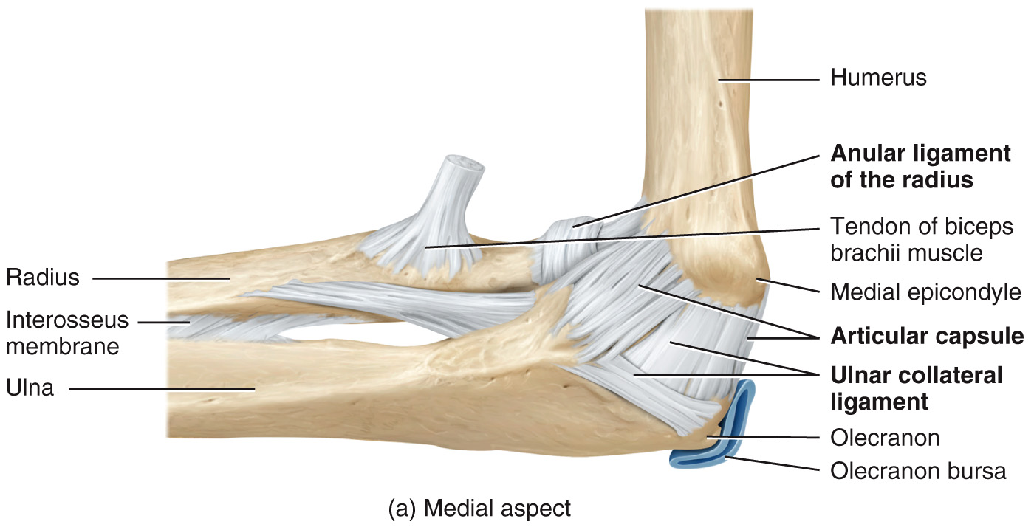
Selected Joints – Elbow
elbow: hinge joint formed by the humerus (trochlea and capitulum), ulna (trochlear notch), and radius (head) → allows for flexion and extension of the forearm
21

Slide 22
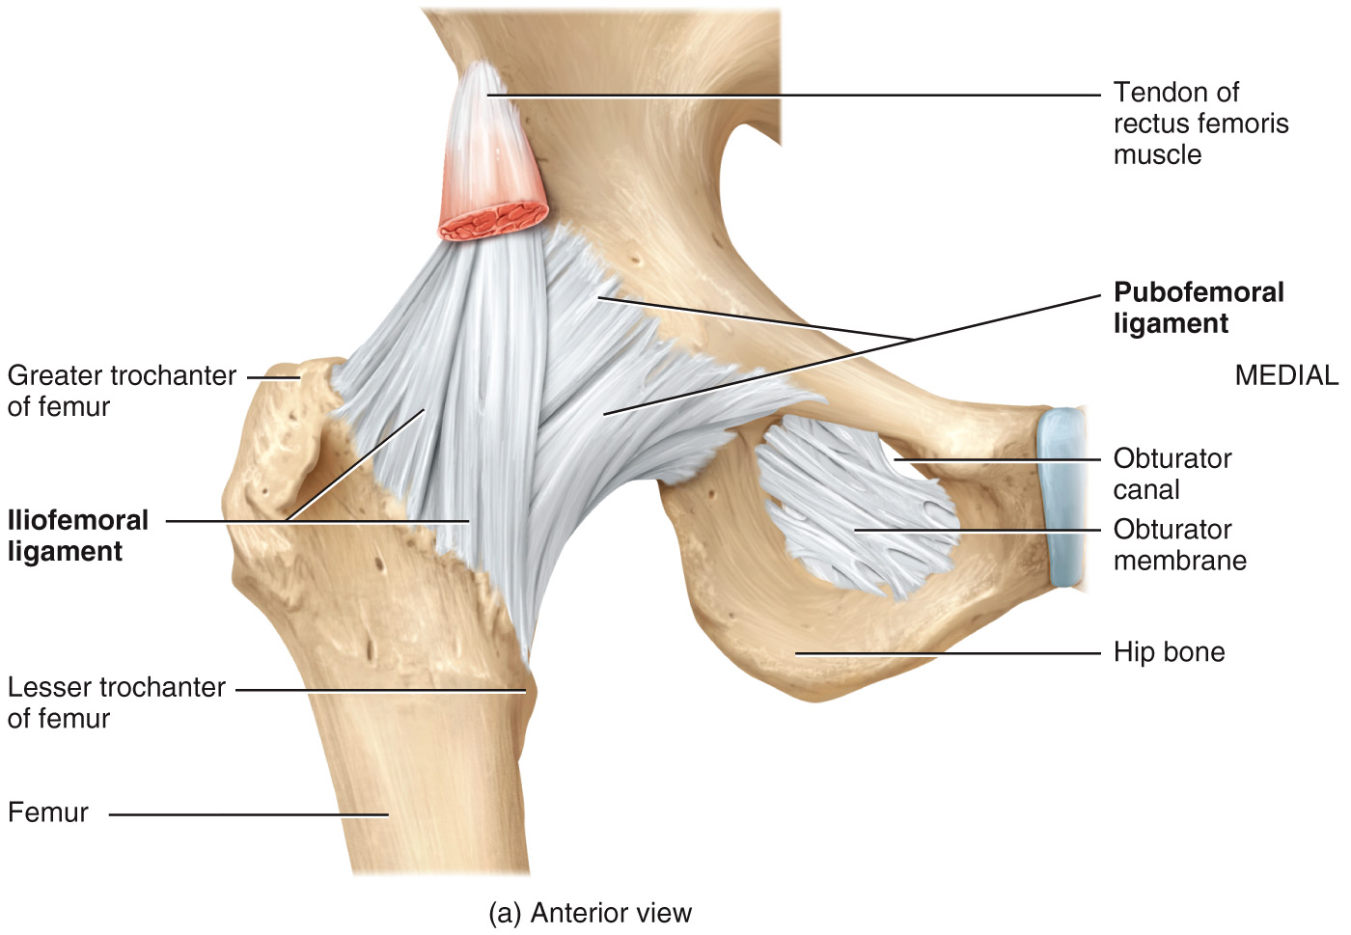
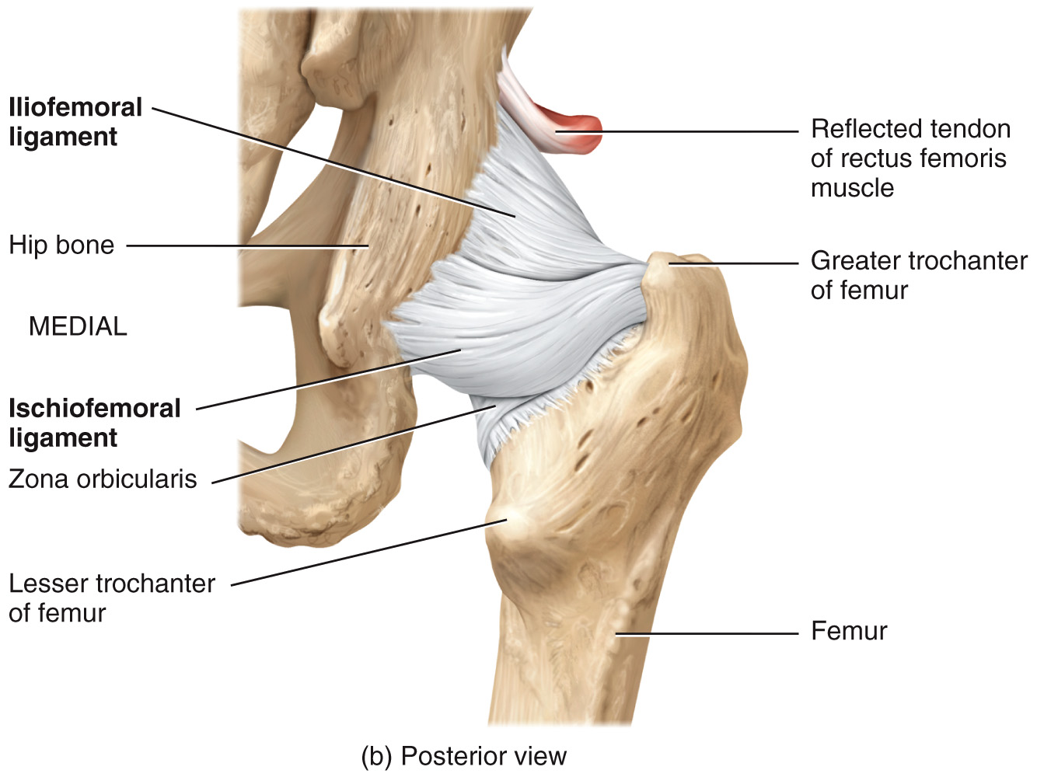
Selected Joints – Acetabulofemoral (Hip) Joint
hip: ball-and-socket joint formed by the head of the femur and acetabulum of the hip bone → allows flexion, extension, abduction, adduction, lateral rotation, medial rotation, and circumduction of thigh → extreme stability of hip is related to (1) the very strong articular capsule and accessory ligaments (2) the manner in which the femur fits into the acetabulum (3) muscles surrounding the joint
22

Slide 23
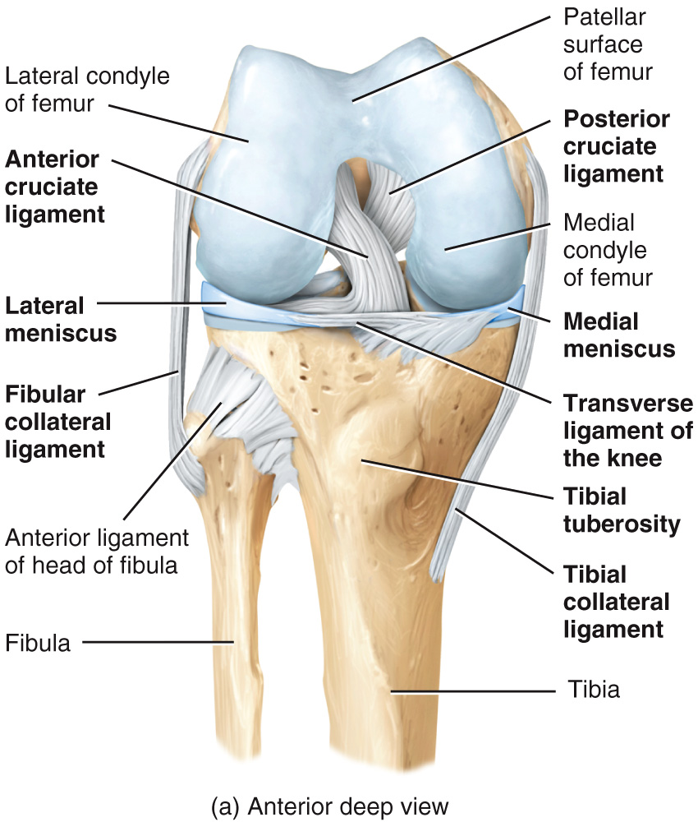
Selected Joints – Tibiofemoral (Knee) Joint
knee: largest and most complex joint in the body → it is a modified hinge joint → allows for flexion, extension, slight medial and lateral rotation of the leg
23

Slide 24
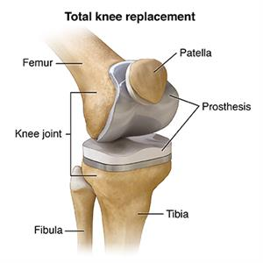
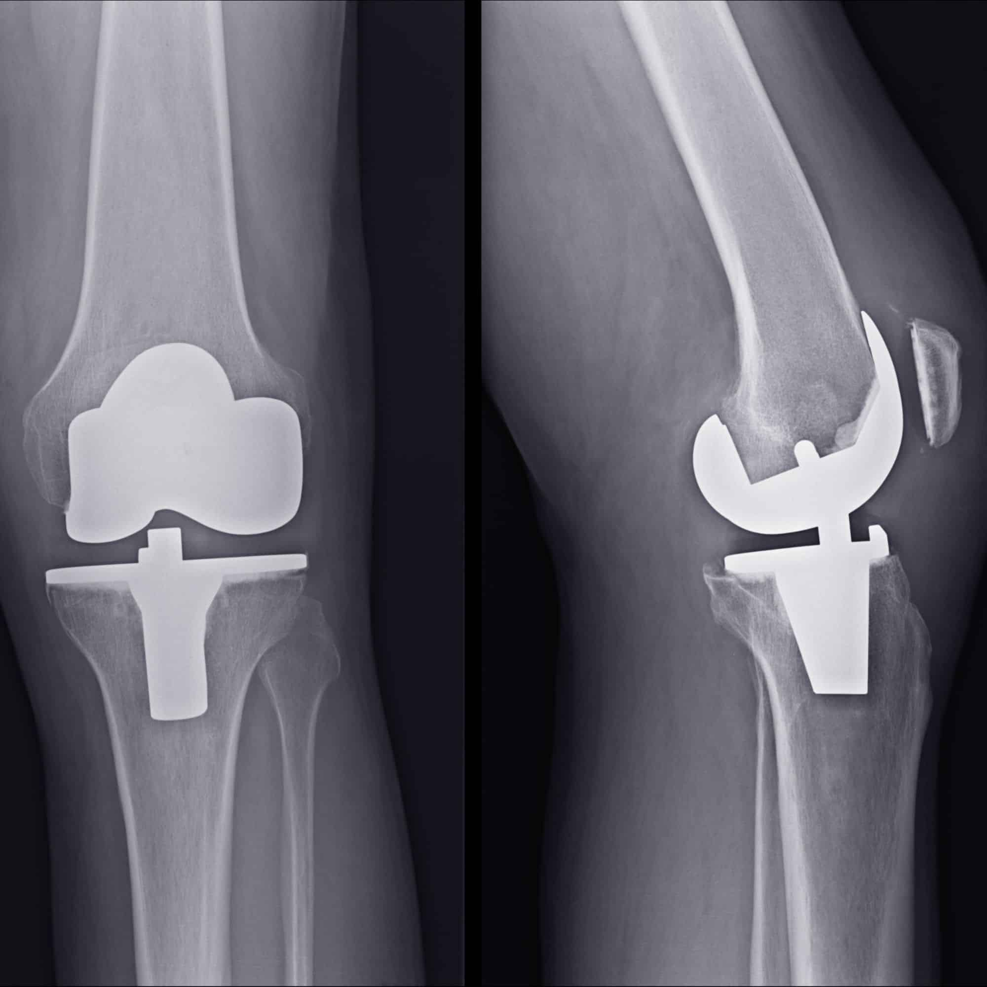
Clinical Connection – Arthroplasty
arthroplasty: a surgical procedure to restore the function of a joint (ex. by resurfacing the bone) → commonly performed on patients w/ osteoarthritis = a condition in which the articular cartilage deteriorates over time
24

Slide 25
Watch These Videos:
Videos from the textbook:
Joints
Cartilaginous JOINTS
Structural Subtypes of Synovial Joints
Videos from the internet:
https://www.youtube.com/watch?v=DLxYDoN634c&t=14s

